Slide 1


AI FOR ALL PROJECT
TOPIC:
SPEECH RECOGNIZED GRAPH CALCULATOR
Done by:
Eshaan Mathur(RVCE22BCS070)
Bandaru Jnyandeep(RVCE22BCY043)

Slide 2

Contents
Introduction
Problem Statement
Objectives
Design
Output and Analysis

Slide 3
Introduction:
This project is an AI based graph plotter which plots graphs by speech recognition.
The user can plot a graph with less strain only just by tell the instructions and the values to the compute the graph.
This makes it easier for people in work sectors who need constant generation of graphs and they do not really need to type down the parametric values.

Slide 4
Problem Statement
Develop an AI-powered system that can accurately recognize and convert spoken mathematical expressions and equations , and convert them to graphs in real-time.
The goal is to provide a more intuitive and accessible way for students, teachers and especially people working in the sector involving statistics to interact with mathematical concepts integrated with computer systems.

Slide 5
Objectives:
Give a complete exposure of someone to Artificial Intelligence using speech recognition and auto generation with user specified values.
An introduction to interaction with computer-based systems that can help one understand graphs more deeply.
An ease in graph generation as we have to just speak about the shape and parameters of the graph we want. This application can further develop graphs which might have various mathematical predictions tools for the future

Slide 6
Design
We have made use of sympy module that consist of an important function called plot_implicit.
We also made use of speech_recognition module in the program so as to obtain a command which we speak.
We made use of regular expression to perform operations on the recognized speech.

Slide 7

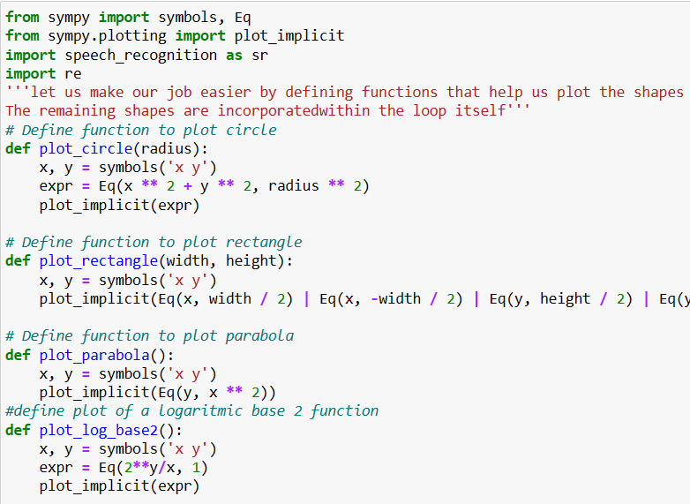

CODE
Libraries Used
sympy for symbolic mathematics and plotting implicit functions
numpy for numerical computing
speech_recognition for speech recognition from the user

Slide 8
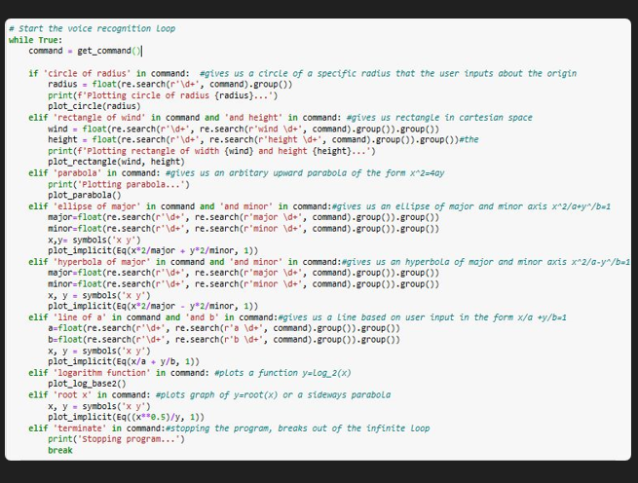
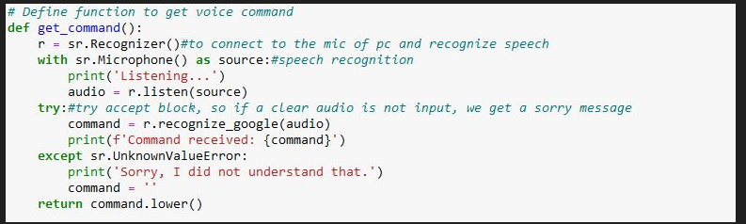
The program defines several functions to plot different shapes, including a circle, rectangle, parabola, logarithmic function, ellipse, hyperbola, and line. It also defines a function to get voice commands from the user . The main part of the program is an infinite loop that continuously listens for voice commands from the user. When a command is recognized, the program checks which shape to plot based on the keywords in the command.

Slide 9
DEMONSTRATION
For example, if the command contains the phrase "circle of radius", the program extracts the radius value from the command and calls the plot_circle function to plot a circle with the specified radius. Similarly, if the command contains the phrase "rectangle of width" and "and height", the program extracts the width and height values and calls the plot_rectangle function to plot a rectangle with the specified dimensions. The program continues to listen for commands until the user says "terminate", at which point the program exits the loop and stops.

Slide 10
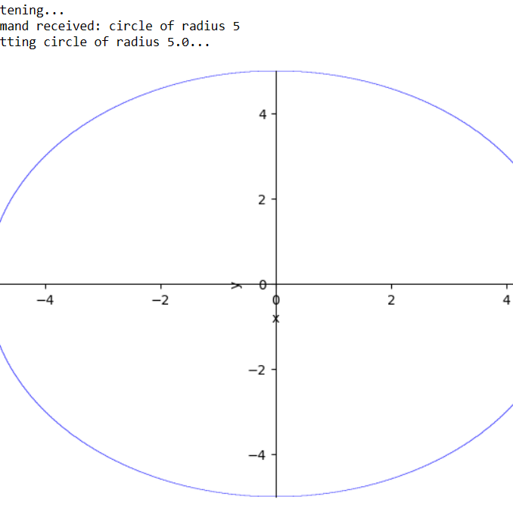
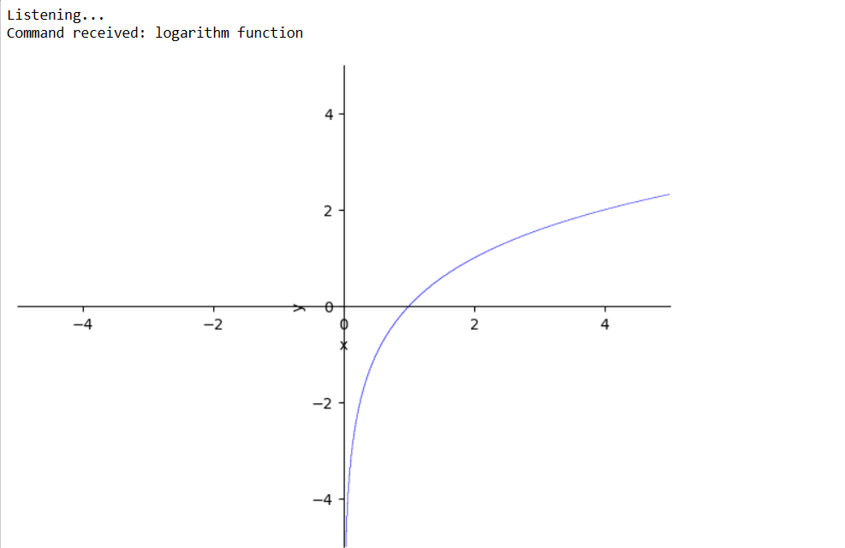
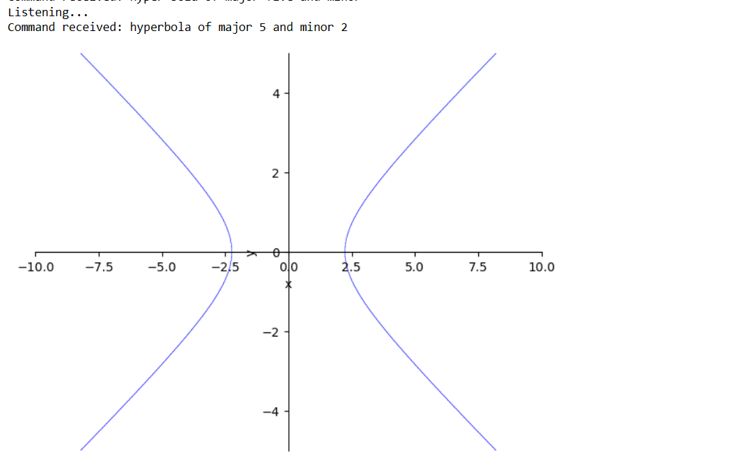
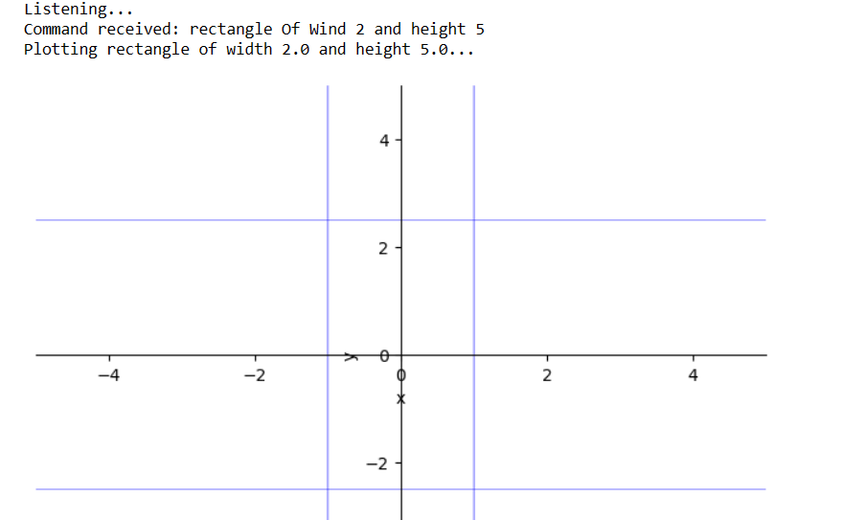
Output and Analysis

Slide 11
The program generates a graph of a desired figure. It can generate the graphs of the following:
A circle with a radius
A rectangle
Upward Parabola(arbitrary)
An ellipse with major and minor axis
A hyperbola with major and minor axis
A line with x and y intercepts
Logarithm base 2 function log
A sideward parabola
RESULTS

